Slide 1
Name:Apurva kumar Project name: Basic calculator organisation Name : NextHikes IT Solutions

Slide 2
Features of a Basic GUI Calculator:
Number Input: Buttons for digits 0-9 and a decimal point, allowing users to enter numbers.
Operator Input: Buttons for addition (+), subtraction (-), multiplication (*), and division (/) operators.
Equals Button: A button to trigger the calculation and display the result.
Clear Button: A button to reset the input and clear the display.
Display Area: A text field or label to show the entered expression and the calculated result.
Functionality: The calculator evaluates user input, performs the specified arithmetic operation, and displays the outcome in the display area.
Error Handling: Basic error handling, such as preventing division by zero or displaying an error message for invalid inputs.
User Interaction: The calculator responds to user clicks on buttons, updating the display and performing calculations accordingly
FUNCTION OF BASIC CALCULATOR
A basic GUI (Graphical User Interface) calculator's primary function is to perform fundamental arithmetic operations like addition, subtraction, multiplication, and division. It achieves this by allowing users to interact with a visual interface, typically with number buttons, operation buttons (e.g., +, -, *, /), and an output display.

Slide 3
we can use Python’s Tkinter module to create a GUI-based calculator. Tkinter is a standard Python module for creating graphical user interfaces.
class Calculator:
def __init__(self, master):
self.master = master
master.title("Calculator")
# Create the entry fieldCreate the buttons
self.entry = tk.Entry(master, width=30, justify='right', font=('Arial', 16))
self.entry.grid(row=0, column=0, columnspan=4, padx=10, pady=10)
In this code, we create a class called Calculator that inherits from the tkinter.Frame class.
We make an instance of this class by calling the Tk() function, which opens a new window.
We then create an entry field for the calculator as well as a series of buttons that represent the calculator’s digits, operators, and other functions.
def create_button(self, text, row, column):
button = tk.Button(self.master, text=text, width=5, height=2, font=('Arial', 16), command=lambda: self.button_click(text))
button.grid(row=row, column=column, padx=5, pady=5)
We assign a command to each button that is called when the button is clicked, and we implement these commands in the Calculator class’s `button click` method.

Slide 4
import tkinter as tk
class Calculator:
def __init__(self, master):
self.master = master
master.title("Basic Calculator")
self.entry = tk.Entry(master, width=30, justify='right', font=('Arial', 18))
self.entry.grid(row=0, column=0, columnspan=4, padx=10, pady=10)
self.create_button("1", 1, 0)
self.create_button("2", 1, 1)
self.create_button("3", 1, 2)
self.create_button("4", 2, 0)
self.create_button("5", 2, 1)
self.create_button("6", 2, 2)
self.create_button("7", 3, 0)
self.create_button("8", 3, 1)
self.create_button("9", 3, 2)
self.create_button("0", 4, 1)
self.create_button(".", 4, 2)
self.create_button("+", 1, 3)
self.create_button("-", 2, 3)
self.create_button("*", 3, 3)
self.create_button("/", 4, 3)
self.create_button("=", 4, 0)
self.create_button("C", 5, 0)
self.create_button("CE", 5, 1)
self.create_button("(", 5, 2)
self.create_button(")", 5, 3)
def create_button(self, text, row, column):
button = tk.Button(self.master, text=text, width=5, height=2, font=('Arial', 16), command=lambda: self.button_click(text))
button.grid(row=row, column=column, padx=5, pady=5)
def button_click(self, text):
if text == "=":
try:
result = str(eval(self.entry.get()))
self.entry.delete(0, tk.END)
self.entry.insert(0, result)
except:
self.entry.delete(0, tk.END)
self.entry.insert(0, "Error")
elif text == "C":
self.entry.delete(0, tk.END)
elif text == "CE":
self.entry.delete(len(self.entry.get())-1, tk.END)
else:
self.entry.insert(tk.END, text)
root = tk.Tk()
calculator = Calculator(root)
root.mainloop()

Slide 5
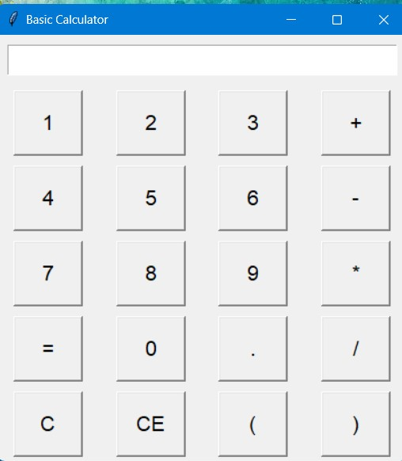

Slide 6
Thanku

